Slide 1

Global Life Expectancy Analysis
A Data-Driven Health Insight
Presented by ; GOONDAM RAMALINGAM VENKAT
Date: [Presentation Date]

Slide 2

Understanding the Challenge
Life expectancy varies significantly across countries, presenting a complex global health challenge. Our project aims to identify the key factors influencing these disparities.

Slide 3
Our Core Objectives
1
Analyze Trends
2
Correlate Factors
3
Visualize Insights
Examine patterns and changes in global life expectancy over time.
Investigate relationships between life expectancy and socio-economic/health indicators.
Utilize visualizations and statistical methods to derive meaningful conclusions.

Slide 4
Dataset Overview
Our analysis is based on comprehensive data from reputable sources like the WHO and UN. The dataset includes various attributes crucial for understanding life expectancy.
Country, Year
Geographical and temporal identifiers.
Life Expectancy
The primary dependent variable.
GDP, Schooling
Socio-economic indicators.
Alcohol, Immunization
Health-related factors.

Slide 5



Data Preparation
Rigorous data cleaning and preprocessing were essential to ensure the accuracy and reliability of our analysis. This involved several critical steps.
Removed Duplicates
Handled Missing Values
Standardized Formats
Ensured unique entries for accurate analysis.
Addressed gaps in data through imputation or removal.
Ensured consistency across all data attributes.

Slide 6
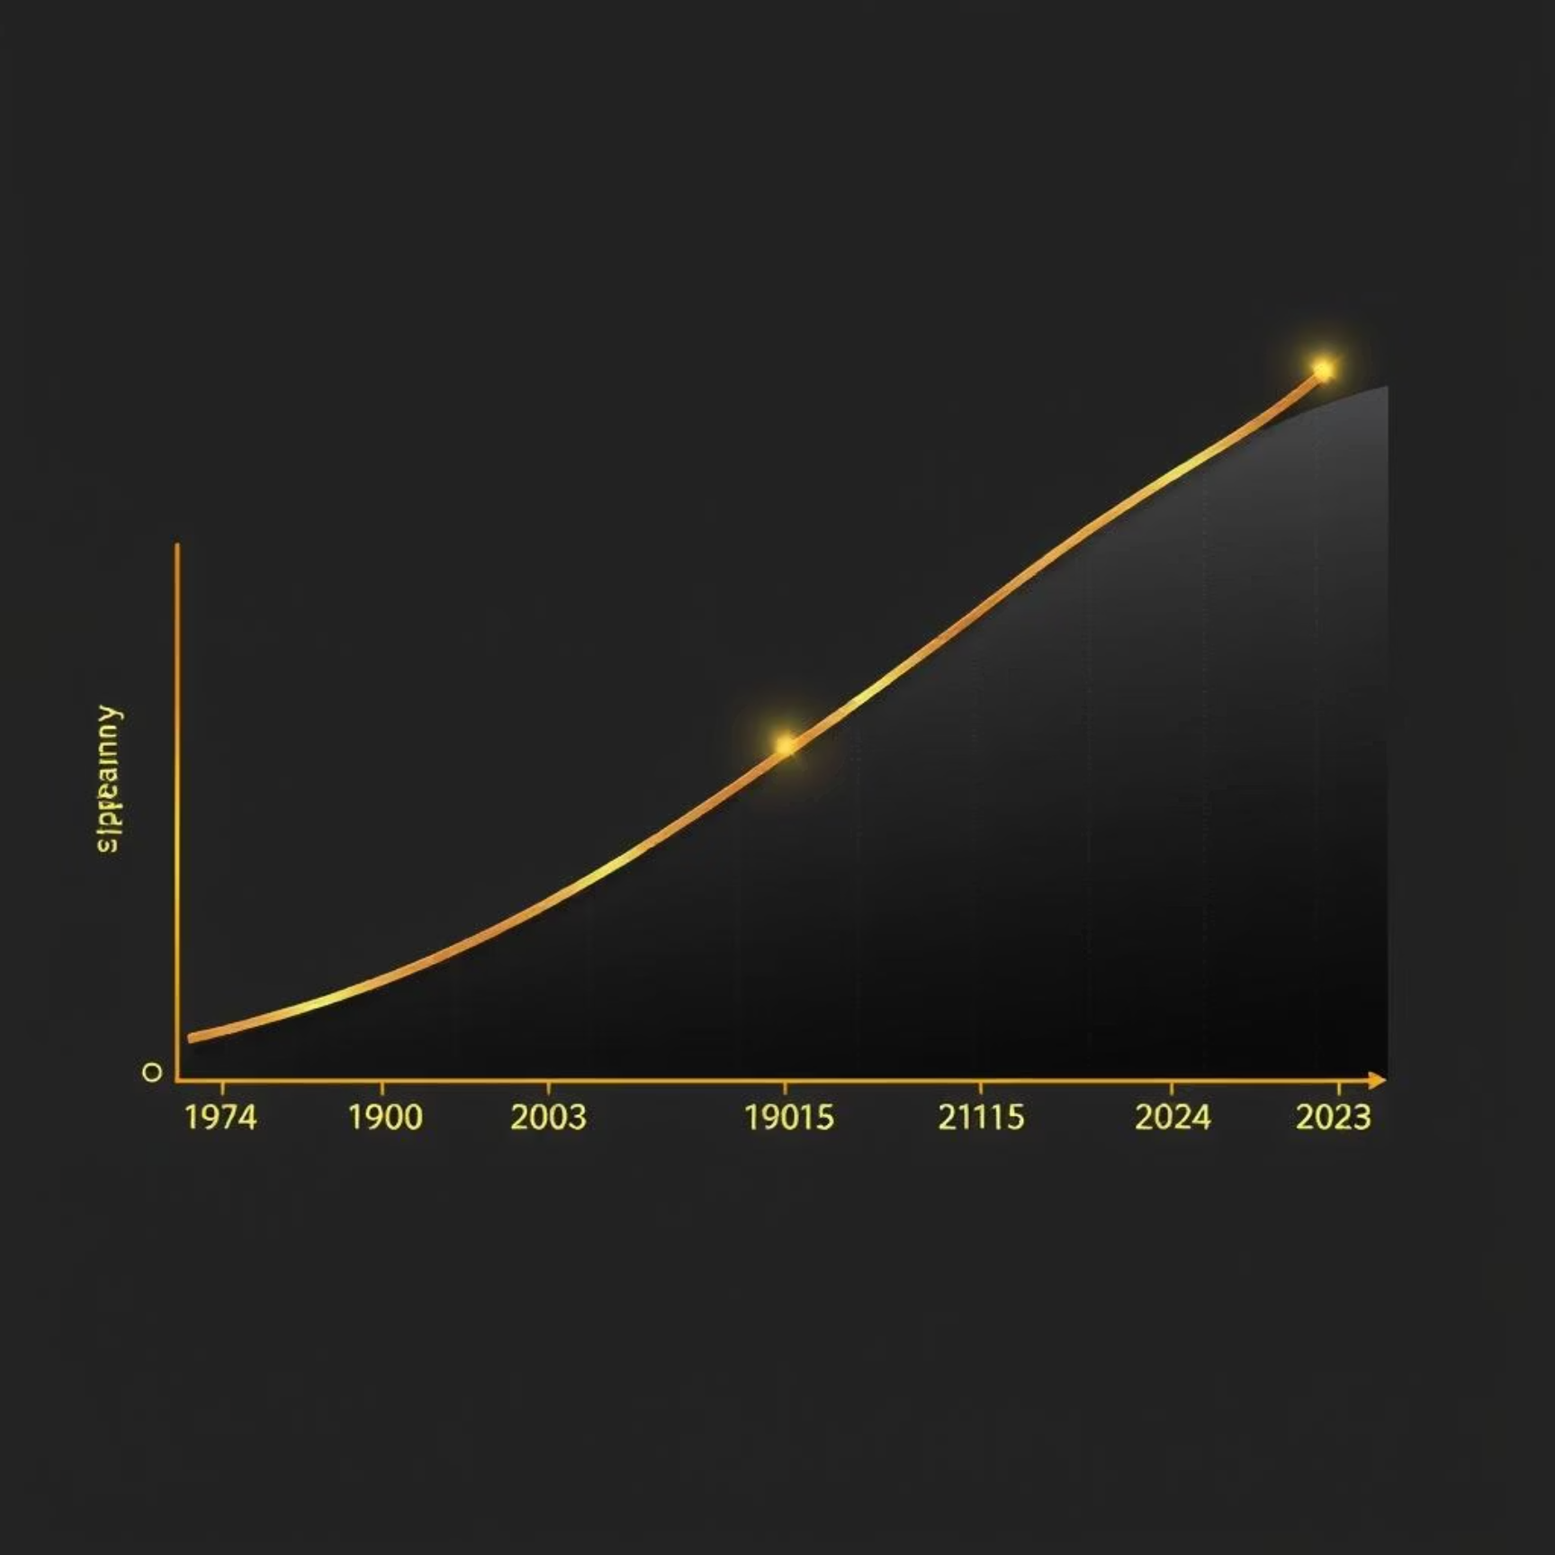
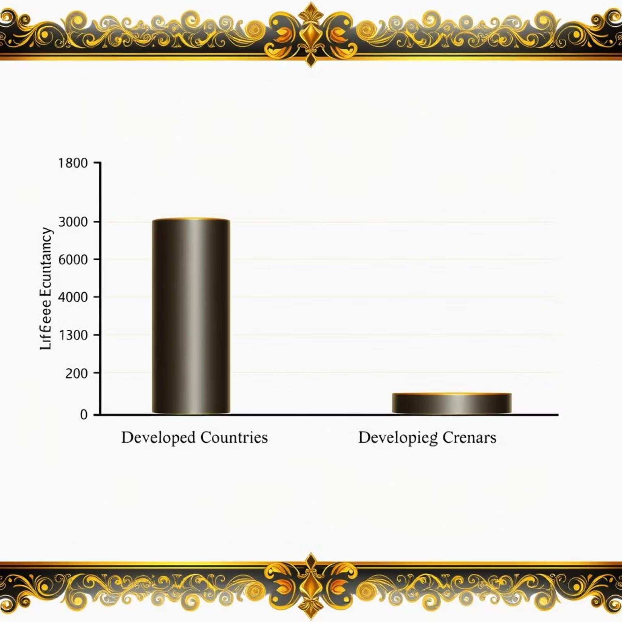
Key Visualizations
Visualizations played a crucial role in uncovering patterns and relationships within the data, making complex insights easily digestible.
Life expectancy trends over time.
Comparison between developed vs. developing countries.
Heatmaps were also used for detailed correlation analysis.

Slide 7



Key Findings
Positive Correlation
Negative Impact
Socio-Economic Link
GDP, schooling, and immunization rates show a strong positive correlation with increased life expectancy.
Factors like alcohol consumption, infant deaths, and adult mortality rates negatively impact life expectancy.
Countries with higher income levels and better educational systems generally exhibit longer life expectancies.

Slide 8

Conclusion & Recommendations
Our analysis highlights that health, education, and economic stability are the primary drivers of life expectancy. To improve global health outcomes, policy efforts should be strategically focused.
Policies should prioritize improving public health infrastructure, promoting widespread literacy, and fostering economic growth to enhance life expectancy globally.

Slide 9
Future Directions
Building on this foundational analysis, our next steps involve leveraging advanced analytical techniques to further deepen our understanding of life expectancy.
Predictive Modeling
Country Clustering
Utilize machine learning regression models to predict future life expectancy based on identified factors.
Group countries based on their health profiles and socio-economic indicators to identify common challenges and opportunities.

